Slide 1
Bank MANAGEMENT SYSTEM
Beepata Santoshi
Batch :2021-6139
Enrollment Number :EBEON1021450302

Slide 2
Abstract
The program accepts the number of customers we need to add and adds the customer and account details accordingly. Further, it displays the series of menus to operate over the accounts.
The series of menus displayed are as follows:
Display all account details
Search by account number
Deposit the amount
Withdraw the amount
Exit

Slide 3
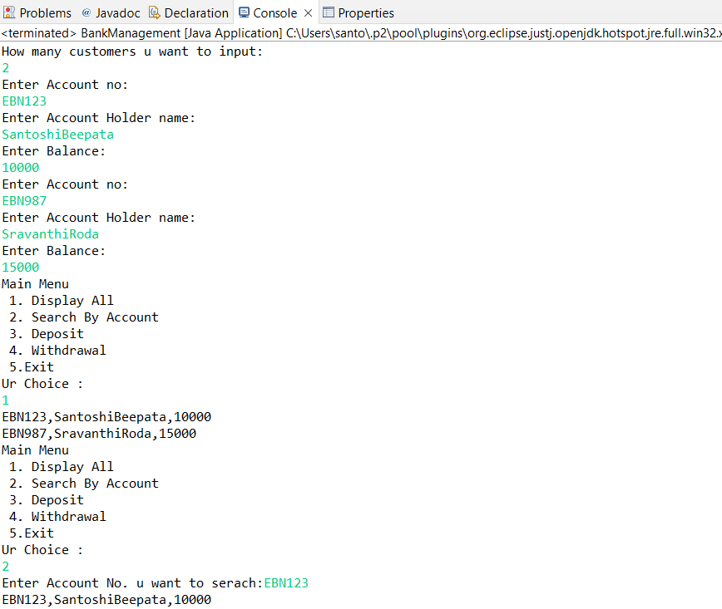
Outputs

Slide 4
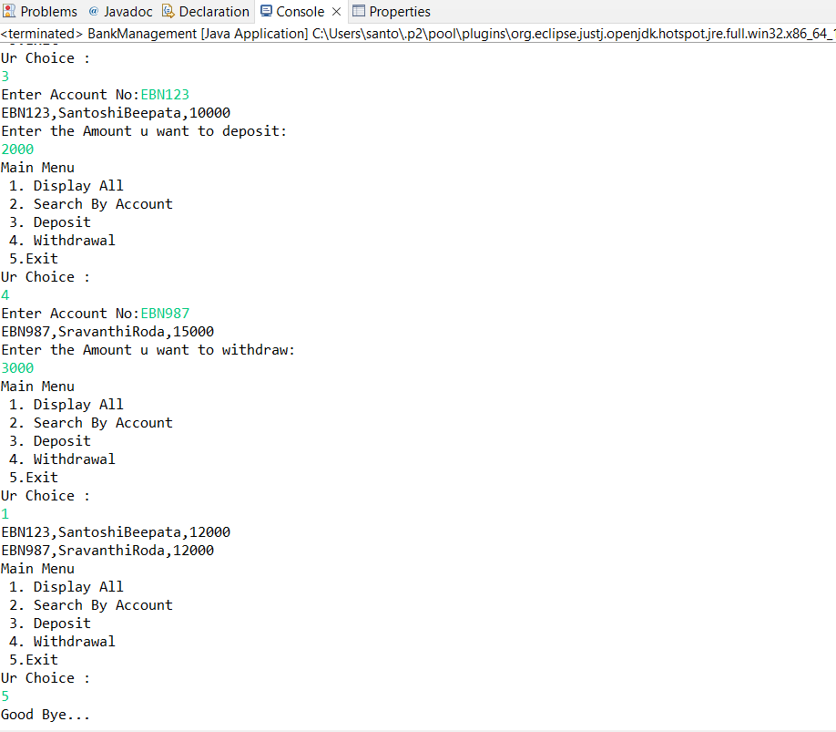

Slide 5
THANK YOU

